Slide 1


SUPERMART GROCERY SALES
RETAIL ANALYTICS
BY:
MADIREDDY BHARATH KUMAR REDDY
16/09/2024

Slide 2

The Supermart Grocery Orders dataset contains information on grocery orders placed by customers through a delivery application in Tamil Nadu, India. This analysis aims to extract meaningful insights into customer purchasing patterns, sales trends, and the overall performance of the grocery delivery platform, providing a clearer understanding of the operational efficiency and business dynamics within the grocery sector.
INTRODUCTION

Slide 3

DATASET OVERVIEW
THE DATASET CONSISTS OF THE FOLLOWING KEY COLUMNS:
01
ORDER ID: UNIQUE IDENTIFIER FOR EACH ORDER.
06
REGION: GEOGRAPHICAL REGION (E.G., WEST, EAST) OF THE CUSTOMER’S CITY.
02
CUSTOMER NAME: NAMES OF CUSTOMERS PLACING THE ORDERS.
07
SALES: TOTAL SALES AMOUNT FOR EACH ORDER.
03
CATEGORY & SUBCATEGORY: TYPES OF PRODUCTS ORDERED, SUCH AS SNACKS, BEVERAGES, FRUITS, AND VEGETABLES.
08
DISCOUNT: DISCOUNTS APPLIED TO EACH ORDER.
04
CITY: CUSTOMER'S LOCATION, LIMITED TO CITIES WITHIN TAMIL NADU.
09
PROFIT: PROFIT EARNED PER ORDER.
05
ORDER DATE: THE DATE WHEN THE ORDER WAS PLACED.

Slide 4

OBJECTIVES
The objectives of this SQL-based analysis are:
To assess the overall sales performance and identify the top-selling products.
To analyze customer trends, including order frequency, product preferences, and geographical patterns.
To examine the profit margins and the impact of discounts on overall sales.

Slide 5
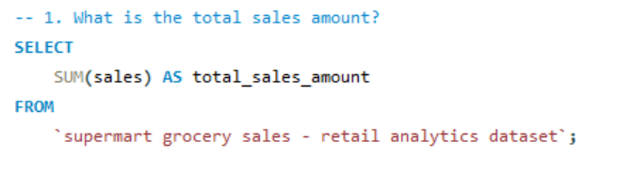
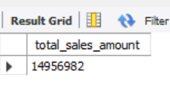
ANALYSIS:
Q1. What is the total sales amount?
Answer:

Slide 6
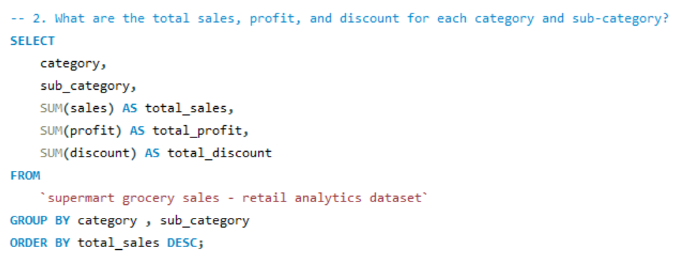
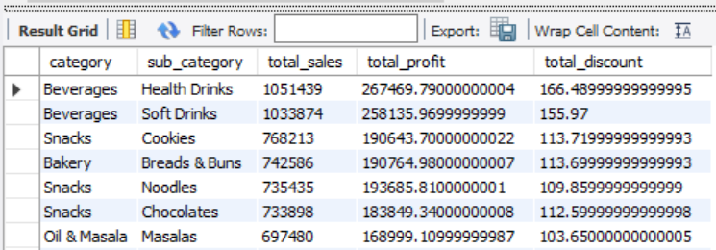
ANALYSIS:
Q2. What are the total sales, profit, and discount for each category and sub-category?
Answer:

Slide 7
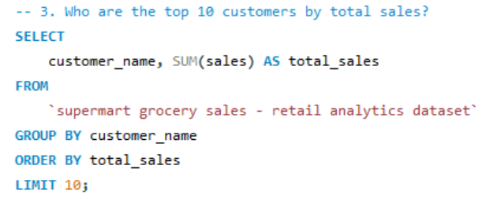
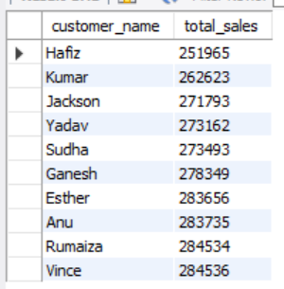
ANALYSIS:
Q3. Who are the top 10 customers by total sales?
Answer:

Slide 8
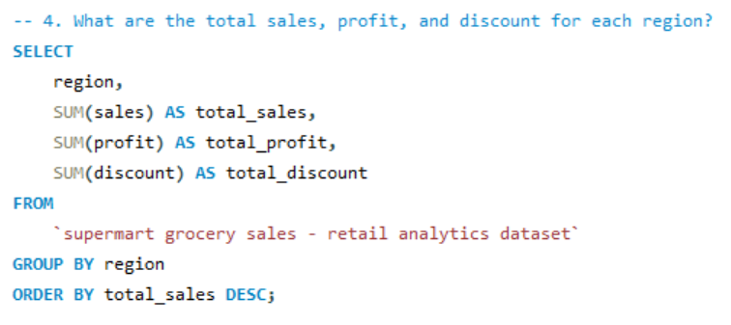
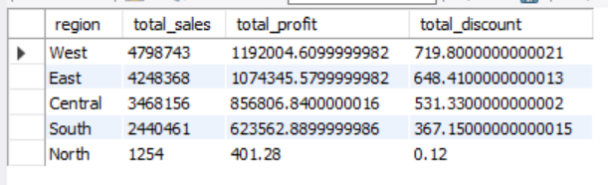
ANALYSIS:
Q4. What are the total sales, profit, and discount for each region?
Answer:

Slide 9
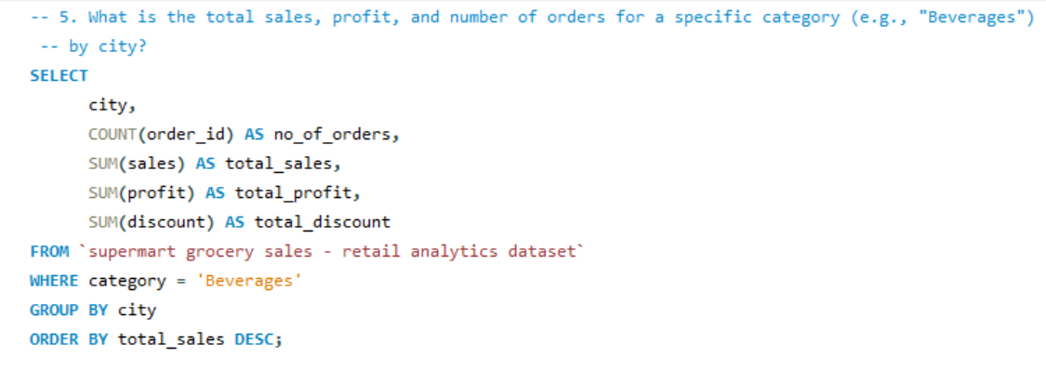
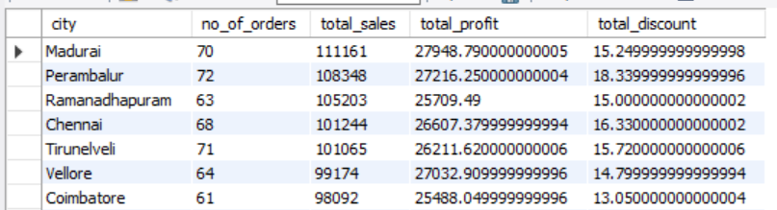
ANALYSIS:
Q5. What is the total sales, profit, and number of orders for a specific category (e.g., "Beverages") by city?
Answer:

Slide 10
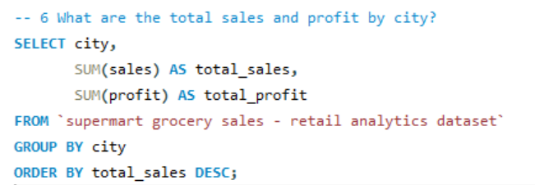
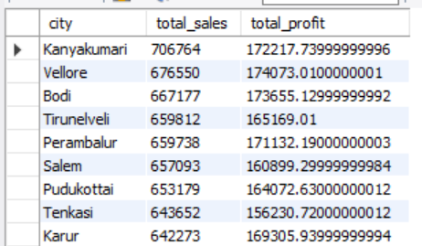
ANALYSIS:
Q6 What are the total sales and profit by city?
Answer:

Slide 11
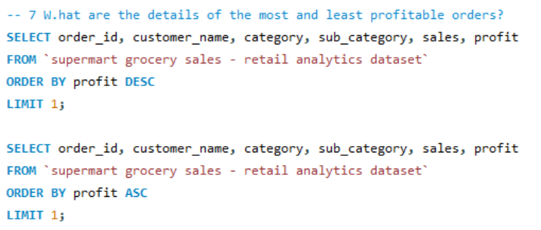


ANALYSIS:
Q7 What are the details of the most and least profitable orders?
Answer:

Slide 12
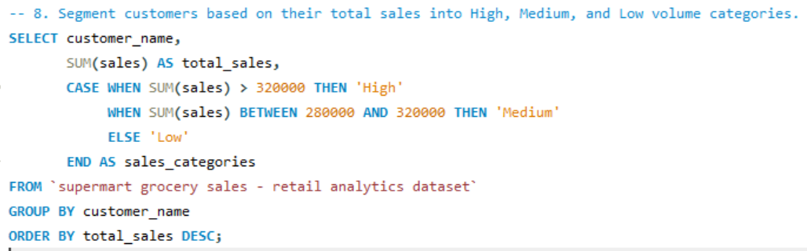
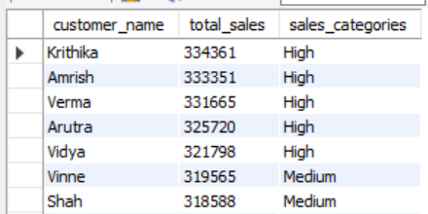
ANALYSIS:
Q8. Segment customers based on their total sales into High, Medium, and Low volume categories.
Answer:

Slide 13
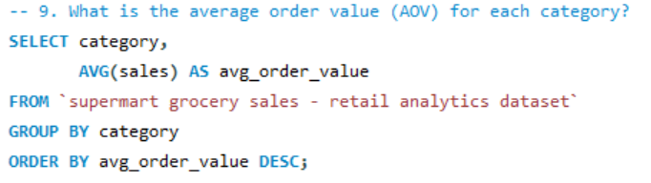
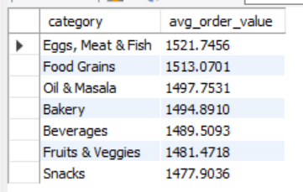
ANALYSIS:
Q9. What is the average order value (AOV) for each category?
Answer:

Slide 14
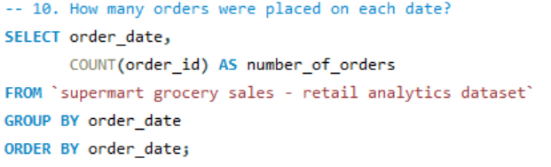
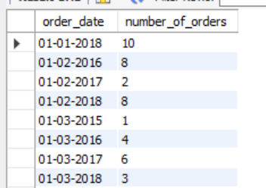
ANALYSIS:
Q10. How many orders were placed on each date?
Answer:

Slide 15
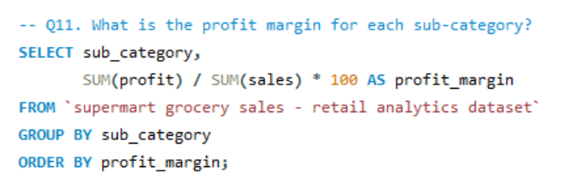
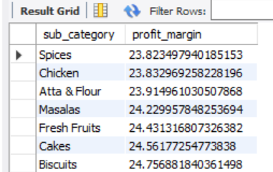
ANALYSIS:
Q11. What is the profit margin for each sub-category?
Answer:

Slide 16
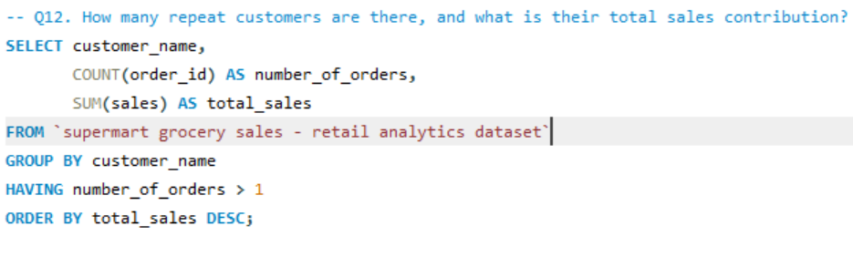
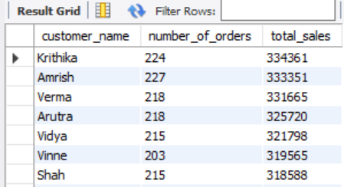
ANALYSIS:
Q12. How many repeat customers are there, and what is their total sales contribution?
Answer:

Slide 17
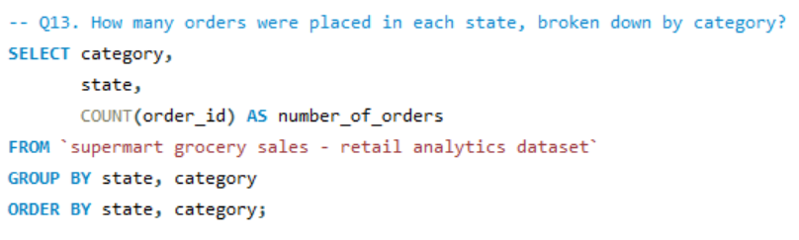
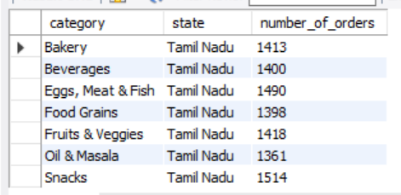
ANALYSIS:
Q13. How many orders were placed in each state, broken down by category?
Answer:

Slide 18
INSIGHTS
Top Sales Categories:
Profit and Discount Relationship:
01
04
The "Beverages" category, especially "Health Drinks," leads sales, contributing over ₹1 million.
Profits fluctuate with increasing discounts, indicating that a balance between discounting and profitability is crucial.
Regional Sales:
City Performance:
02
The "West" region tops sales with ₹4.8 million, followed by the "East" region, showing strong regional demand.
05
Kanyakumari leads city-wise sales, with over ₹700,000 in revenue, indicating strong urban demand.
Customer Segmentation:
Order Trends:
03
06
High-volume customers contribute significantly, with several exceeding ₹320,000 in total sales.
Urban centers like Madurai and Chennai exhibit strong demand for "Beverages," with high order volumes, offering opportunities for focused marketing and inventory optimization in these key cities.

Slide 19

RECOMENDATIONS
01
Optimize Discounts
Refine discount strategies to boost profits while maintaining customer interest.
02
Regional Focus
Expand operations and promotions in high-demand regions like the West and key cities like Kanyakumari.
03
Loyalty Programs:
Develop targeted loyalty initiatives for high-volume customers to increase retention.
04
Product Expansion:
Increase the variety of beverages, especially health-related products, to capture more sales.

Slide 20
CONCLUSION
01
02
03
Data-driven Insights:
Actionable Strategies:
Future Potential:
The analysis identifies key patterns in top-performing categories like Beverages and Snacks, and regions such as the West and East. High-value customers and sales trends are also highlighted.
Supermart can enhance performance by targeting high-sales regions, optimizing discounts in lower-performing areas, and fostering customer loyalty to boost sales and profitability.
By applying these strategies, Supermart has the potential to increase market share, improve profitability, and meet evolving customer needs more effectively.

Slide 21
THANK YOU

